Slide 1
Overview of Programming Language

Slide 2
Some Basic Points
What is a language? - Language is the medium of communication to share ideas, opinion with each other.
What is a programming language? - Programming language is the medium of communication between you (a person) and a computer system.
Types of computer programming languages - There are basically two types of computer programming languages, they are –
Low Level Programming Languages - Low-level languages are designed to operate and handle the entire hardware and instructions set architecture of a computer directly.
e.g., Machine Language and Assembly Language are popular examples of low-level languages.
High Level Programming Languages - These are the machine independent programming languages, which are easy to write, read, edit and understand.
e.g., The languages like Java, .Net (C#), C++, C etc. are the example of high-level languages.

Slide 3
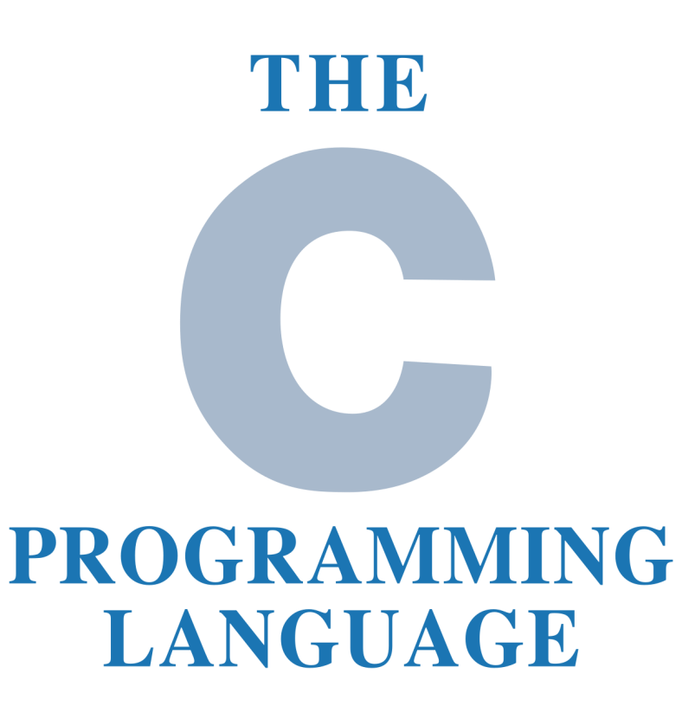
Some Basic Points
Why should I learn programming language? - There are some great reasons, for which we should learn code –
For increasing Logical Ability
Coding Teaches us - How to Approach Problem – Solving
Out of the box Thinking – enhances Creativity
Improved Critical-thinking skills
Programming keeps our mind active and busy… for Lifetime
Being Able to Turn an Idea Into an App
Automate Daily Tasks and Save Time

Slide 4
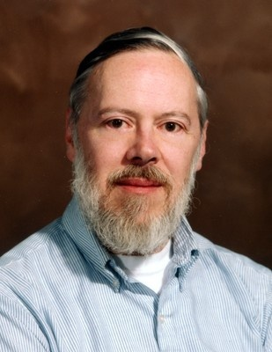
General Aspect -
C was originally developed in the 1970s, by Dennis Ritchie at AT&T Bell Labs, Inc.
C is a mid level, general–purpose structured procedural programming language. Instructions of C consists of terms that are very closely same to algebraic expressions, consisting of certain English keywords such as if, else, for, do and while etc.
C contains certain additional features that allows it to be used at a lower level , acting as bridge between machine language and the high level languages.
These allows C to be used for system programming as well as for applications programming.

Slide 5
Features of C Language -
C is the widely used language. It provides many features that are given below –
Simple
Machine Independent or Portable
Mid-level programming language
structured programming language
Rich Library
Memory Management
Fast Speed
Pointers
Recursion
Extensible

Slide 6
Basic Structure of C language -
#include<stdio.h>
#include<conio.h>
void main()
{
clrscr();
printf("Hello World\n");
getch();
}
Explanation –
#include<stdio.h> - Includes the standard input output library functions. The printf() function is defined in stdio.h .
void main() - The main() function is the entry point of every program in c language.
printf() - The printf() function is used to print data on the console.

Slide 7
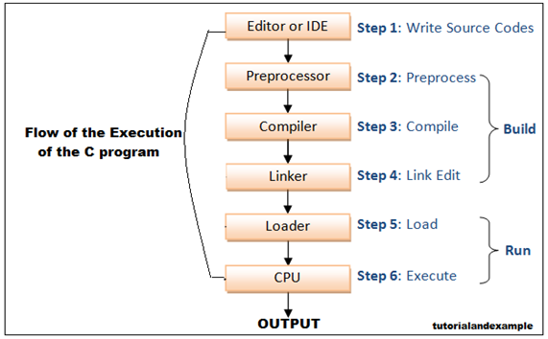
Flow of C Program -

Slide 8
The Basic Structure of C Programming
#include<stdio.h>
#include<conio.h>
void main()
{
}
Standard Include Statements
Main function

Slide 9
printf() and scanf() in C -
The printf() and scanf() functions are used for input and output in C language. Both functions are inbuilt library functions, defined in stdio.h (header file).
printf() function -
The printf() function is used for output. It prints the given statement to the console.
printf("format string", argument_list);
scanf() function –
The scanf() function is used for input. It reads the input data from the console.
scanf("format string", argument_list);

Slide 10
The Character set of ‘C’ -
C language consist of some characters set, numbers and some special symbols. The character set of C consist of all the alphabets of English language. C consist of the followings –
Token - The words formed from the character set are building blocks of C and are sometimes known as tokens. These tokens represent the individual entity of language.
The following different types of token are used in C –
Identifiers
Variables
Keywords
Constants
Operators
Punctuators
Alphabets | a to z, A to Z
Numeric | 0,1 to 9
Special Symbols | {}, [], ?, +, -, *, /, %, ! etc.

Slide 11
Identifiers in C -
A 'C' program consist of two types of elements –
User Defined
System Defined
Identifiers is nothing but a name given to these elements. An identifier is a word used by a programmer to name a variable , function, or label.
Naming Conventions of a Identifiers –
Identifiers consist of letters and digits, in any order, except that the first character or label.
Identifiers consist of letters and digits if any order, except that the first character must be letter.
Both Upper and lowercase letters can be used

Slide 12
Variables in C -
A variable is a name of the memory location. It is used to store data. Its value can be changed, and it can be reused many times. It is a way to represent memory location through symbol so that it can be easily identified.
type variable_list;
The example of declaring the variable is given below –
int a;
float b;
char c;
Note: Here, a, b, c are variables. The int, float, char are the data types.
We can also provide values while declaring the variables as given below –
int a=10, b=20; //declaring 2 variable of integer type
float f=20.8;
char c='A';

Slide 13
Rules for defining variables -
A variable can have alphabets, digits, and underscore.
A variable name can start with the alphabet, and underscore only. It can't start with a digit.
No whitespace is allowed within the variable name.
A variable name must not be any reserved word or keyword, e.g. int, float, etc.
Valid variable names -
int a;
int _ab;
int a30;
Invalid variable names -
int 2;
int a b;
int long;

Slide 14
Types of Variables in C -
There are many types of variables in c -
local variable
global variable
static variable
automatic variable
external variable

Slide 15
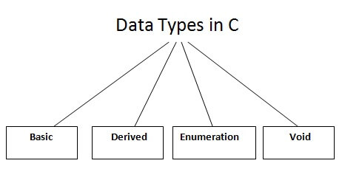
Data Types in C -
A data type specifies the type of data that a variable can store such as integer, floating, character etc.

Slide 16
Data Types in C -
There are the following data types in C language –
Types | Data Types
Basic or Primitive Data Types | int, char, float, double
Derived or Aggregate Data Types | array, pointer, structure, union
User defined Data Type | enum
Void Data Type | void
Basic Data Types –
The basic data types are integer-based and floating-point based. C language supports both signed and unsigned literals. The memory size of the basic data types may change according to 32 or 64-bit operating system. Let's see the basic data types. Its size is given according to 32-bit architecture.
Note: All other data types will discuss later.

Slide 17
Data Types in C -
Data Types | Memory Size | Range
char | 1 byte | −128 to 127
signed char | 1 byte | −128 to 127
unsigned char | 1 byte | 0 to 255
short | 2 byte | −32,768 to 32,767
signed short | 2 byte | −32,768 to 32,767
unsigned short | 2 byte | 0 to 65,535

Slide 18
Data Types in C -
Data Types | Memory Size | Range
int | 2 byte | −32,768 to 32,767
signed int | 2 byte | −32,768 to 32,767
unsigned int | 2 byte | 0 to 65,535
short int | 2 byte | −32,768 to 32,767
signed short int | 2 byte | −32,768 to 32,767
unsigned short int | 2 byte | 0 to 65,535
long int | 4 byte | -2,147,483,648 to 2,147,483,647
signed long int | 4 byte | -2,147,483,648 to 2,147,483,647
unsigned long int | 4 byte | 0 to 4,294,967,295
float | 4 byte
double | 8 byte
long double | 10 byte

Slide 19
Keywords in C -
A keyword is a reserved word. You cannot use it as a variable name, constant name, etc. There are only 32 reserved words (keywords) in the C language.
A list of 32 keywords in the c language is given below –
auto | break | case | char | const | continue | default | do
double | else | enum | extern | float | for | goto | if
int | long | register | return | short | signed | sizeof | static
struct | switch | typedef | union | unsigned | void | volatile | while

Slide 20
Comments in C -
Comments in C language are used to provide information about lines of code. It is widely used for documenting code. There are 2 types of comments in the C language –
Single Line Comments
Multi-Line Comments
- Single Line Comments – | - Multi Line Comments -
#include<stdio.h> void main() { //printing information printf("Hello C"); } | #include<stdio.h> void main() { /*printing information Multi-Line Comment*/ printf("Hello C"); }

Slide 21
Escape Sequence in C -
An escape sequence in C language is a sequence of characters that doesn't represent itself when used inside string literal or character. It is composed of two or more characters starting with backslash \. For example: \n represents new line.
Escape Sequence | Meaning
\b | Backspace
\n | New Line
\t | Tab (Horizontal)
\v | Vertical Tab
\\ | Backslash
\' | Single Quote
\" | Double Quote
\? | Question Mark
\0 | Null

Slide 22
Constants in C -
A constant is a value or variable that can't be changed in the program, for example: 10, 20, 'a', 3.4, "c programming" etc.
There are different types of constants in C programming.
Categories |  | Constants Name | Example
Numeric Constants | Integer Constant |  | 10, 20, 450 etc.
 | Real Constant | Decimal or Floating-point Constant | 10.3, 20.2, 450.6 etc.
 |  | Octal Constant | 021, 033, 046 etc.
 |  | Hexadecimal Constant | 0x2a, 0x7b, 0xaa etc.
Character Constants | Character Constant |  | 'a', 'b', 'x' etc.
 | String Constant |  | "c", "c program" etc.

Slide 23
Different types of constants -
Integer constants - A integer constant is a numeric constant (associated with number) without any fractional or exponential part. There are three types of integer constants in C programming:
decimal constant(base 10)
octal constant(base 8)
hexadecimal constant(base 16)
Floating-point constants - A floating point constant is a numeric constant that has either a fractional form or an exponent form. For example: 2.0,0.0000234,-0.22E-5 etc.
Character constants - A character constant is a constant which uses single quotation around characters. For example: 'a', 'l', 'm', 'F‘ etc.
String constants- String constants are the constants which are enclosed in a pair of double-quote marks. For example: "good" ,"x", "Earth is round\n"

Slide 24
2 ways to define constant in C -
There are two ways to define constant in C programming.
const keyword
#define preprocessor
const keyword - The const keyword is used to define constant in C programming.
const float PI=3.14;
#include<stdio.h>
void main()
{
const float PI=3.14;
printf("The value of PI is: %f“ , PI);
}
#define preprocessor - The #define preprocessor is also used to define constant. We will learn about #define preprocessor directive later.

Slide 25
Format Specifier in C -
Format specifiers defines the type of data to be printed on standard output. Whether to print formatted output or to take formatted input we need format specifiers. Format specifiers are also called as format string.
Format specifier | Description | Supported data types
%c | Character | char unsigned char
%d | Signed Integer | short unsigned short int long
%e or %E | Scientific notation of float values | float double
%f | Floating point | float

Slide 26
Format Specifier in C -
Format specifier | Description | Supported data types
%g or %G | Similar as %e or %E | float double
%hi | Signed Integer(Short) | short
%hu | Unsigned Integer(Short) | unsigned short
%i | Signed Integer | short unsigned short int long
%l or %ld or %li | Signed Integer | long
%lf | Floating point | double

Slide 27
Format Specifier in C -
Format specifier | Description | Supported data types
%Lf | Floating point | long double
%lu | Unsigned integer | unsigned int unsigned long
%lli, %lld | Signed Integer | long
%llu | Unsigned Integer | unsigned long long
%o | Octal representation of Integer. | short unsigned short int unsigned int long
%p | Address of pointer to void void * | void *

Slide 28
Format Specifier in C -
Format specifier | Description | Supported data types
%s | String | char *
%u | Unsigned Integer | unsigned int unsigned long
%x or %X | Hexadecimal representation of Unsigned Integer | short unsigned short int unsigned int long
%n | Prints nothing
%% | Prints % character

Slide 29
C Operators -
An operator is simply a symbol that is used to perform operations. There can be many types of operations like arithmetic, logical, bitwise etc.
There are following types of operators to perform different types of operations in C language –
Arithmetic Operators
Relational Operators
Shift Operators
Logical Operators
Bitwise Operators
Ternary or Conditional Operators
Assignment Operators
Increment & Decrement Operators
Misc. Operator

Slide 30
Arithmetic Operators -
Operators | Meaning of Operators
+ | Addition or unary plus
- | Subtraction or unary minus
* | Multiplication
/ | Division
% | Modulo Division

Slide 31
Relational Operators -
A relational operator checks the relationship between two operands. If the relation is true, it returns 1; if the relation is false, it returns value 0.
Relational operators are used in decision making and loops.
Operators | Meaning of Operators | Example
== | Equal to | a == b
> | Greater than | a > b
< | Less than | a < b
!= | Not equal to | a != b
>= | Greater than or equal to | a >= b
<= | Less then or equal to | a <= b

Slide 32
Logical Operators -
Logical Operators are used to create compound expressions.
There are 3 logical operators in C –
Logical AND (&&) –
A compound expression formed with && evaluates to true if all of its components are true.
Logical OR (||) -
A compound expression formed with || evaluates to 1 (true) if any one of its components is true.
Logical NOT (!) –
Logical NOT is used to define a compliment of any given expression or value or variable.

Slide 33
Logical Operators -
Operand – 1 (OP1) | Operand – 2 (OP2) | OP1 && OP2 | OP1 || OP2
1 | 1 | 1 | 1
1 | 0 | 0 | 1
0 | 1 | 0 | 1
0 | 0 | 0 | 0

Slide 34
Assignment Operators -
An assignment operator is used for assigning a value to a variable.
Operators | Example | Same As
= | a = b | a = b
+= | a += b | a = a + b
-= | a -= b | a = a – b
*= | a *= b | a = a * b
/= | a /= b | a = a / b
%= | a %= b | a = a % b

Slide 35
Precedence of Operators in C -
The precedence of operator species that which operator will be evaluated first and next. The associativity specifies the operator direction to be evaluated; it may be left to right or right to left.
Category | Operator | Associativity
Postfix | () [] -> . ++ - - | Left to right
Unary | + - ! ~ ++ - - (type)* & sizeof | Right to left
Multiplicative | * / % | Left to right
Additive | + - | Left to right
Shift | << >> | Left to right
Relational | < <= > >= | Left to right

Slide 36
Precedence of Operators in C -
Category | Operator | Associativity
Equality | == != | Left to right
Bitwise AND | & | Left to right
Bitwise XOR | ^ | Left to right
Bitwise OR | | | Left to right
Logical AND | && | Left to right
Logical OR | || | Left to right
Conditional | ?: | Right to left
Assignment | = += -= *= /= %=>>= <<= &= ^= |= | Right to left
Comma | , | Left to right

Slide 37
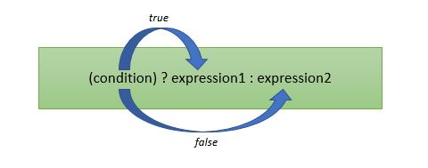
Ternary Operators -
A ternary operator is an operator that takes three operands.
Ternary Operator syntax is ? and :

